Slide 1

Bioinformatics Bootcamp
R for Biologists
Module 2 (continued): Data Frames

Slide 2
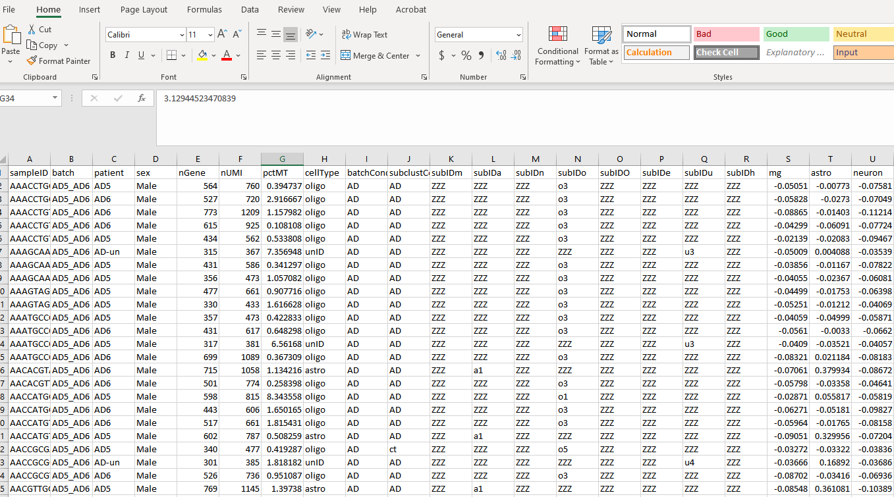

Slide 3
Data Frames
Data Frames are similar to excel sheets. They are 2D arrays which can hold numeric, character, and boolean data. They also have column names.
my_df <- data.frame( "Students" = c("Jimmy", "Alice", "Susan"), "Grades" = c(98, 95, 82) )

Slide 4
Data Frames
Data Frames are similar to excel sheets. They are 2D arrays which can hold numeric, character, and boolean data. They also have column names.
my_df <- data.frame( "Students" = c("Jimmy", "Alice", "Susan"), "Grades" = c(98, 95, 82) ) my_df
## Students Grades ## 1 Jimmy 98 ## 2 Alice 95 ## 3 Susan 82

Slide 5
Data Frames cont.
Data Frames can be accessed numerically by specifying the row and column of interest.
my_df <- data.frame( "Students" = c("Jimmy", "Alice", "Susan"), "Grades" = c(98, 95, 82) )

Slide 6
Data Frames cont.
Data Frames can be accessed numerically by specifying the row and column of interest.
my_df <- data.frame( "Students" = c("Jimmy", "Alice", "Susan"), "Grades" = c(98, 95, 82) ) # What grade did Susan get? my_df[3, 2] # [row, column]

Slide 7
Data Frames cont.
Data Frames can be accessed numerically by specifying the row and column of interest.
my_df <- data.frame( "Students" = c("Jimmy", "Alice", "Susan"), "Grades" = c(98, 95, 82) ) # What grade did Susan get? my_df[3, 2] # [row, column]
## [1] 82

Slide 8
Data Frames cont.
Data Frames can also be accessed by column name with the “$” sign.
my_df <- data.frame( "Students" = c("Jimmy", "Alice", "Susan"), "Grades" = c(98, 95, 82) )

Slide 9
Data Frames cont.
Data Frames can also be accessed by column name with the “$” sign.
my_df <- data.frame( "Students" = c("Jimmy", "Alice", "Susan"), "Grades" = c(98, 95, 82) ) # Access the Grades Column my_df$Grades

Slide 10
Data Frames cont.
Data Frames can also be accessed by column name with the “$” sign.
my_df <- data.frame( "Students" = c("Jimmy", "Alice", "Susan"), "Grades" = c(98, 95, 82) ) # Access the Grades Column my_df$Grades
## [1] 98 95 82

Slide 11
Data Frames cont.
Data Frames can also be accessed by column name with the “$” sign.
my_df <- data.frame( "Students" = c("Jimmy", "Alice", "Susan"), "Grades" = c(98, 95, 82) ) # Access the Grades Column my_df$Grades
## [1] 98 95 82
# What grade did Alice get? my_df$Grades[2]

Slide 12
Data Frames cont.
Data Frames can also be accessed by column name with the “$” sign.
my_df <- data.frame( "Students" = c("Jimmy", "Alice", "Susan"), "Grades" = c(98, 95, 82) ) # Access the Grades Column my_df$Grades
## [1] 98 95 82
# What grade did Alice get? my_df$Grades[2]
## [1] 95

